Slide 1

End-to-end Layer
Computer System Engineering, Fall 2019. (IPADS, SJTU)
Best-effort is not enough
Yubin Xia

Slide 2
Review: Link-State & Distance-Vector
Link-state routing
Nice, easy to reason about failures, but overhead prevents it from scaling. In practice, good for SJTU-sized networks
Distance-vector routing
significantly less overhead, but harder to reason about failures
In practice, good for very small networks (where we can reason about properties of routing loops)

Slide 3
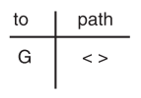
Review: Path Vector Exchange
Each participant maintains a path vector
A complete path to some destination
E.g., zero-length path to itself
Gradually learns about other paths
Construct a new forwarding table from its new path vector
Better for scaling
Like Distance-Vector, but include the full path in the routing advertisements
Overhead increases (advertises are larger), but convergence time decreases (avoid counting to infinity)
Overhead is still lower than Link-State

Slide 4
Case Study: BGP
Border Gateway Protocol

Slide 5
Policy Routing
Regions also want to implement their own policies
Switches make routing decisions based on some policies set by a human
Routing protocol must disseminate enough info to enable those policies
What policies are typical in BGP?
Regions don't want to send traffic on a path unless they have financial incentive to do so
Mechanism of enforcement: selective advertisements
Region-1 won't tell region-2 about a path unless it will make money by letting region-2 use the path
Each region will have a different view of the network, and that view will (almost certainly) not contain every physical link

Slide 6
Typical BGP Relationships
Customer/provider
Customers pay for access (transit), which the provider provides
Peers
Peers provide mutual access to a subset of each's routing tables
The subset that contains their transit customers
Why peer? Can save money and improve performance
Why not peer? You'd rather have customers

Slide 7
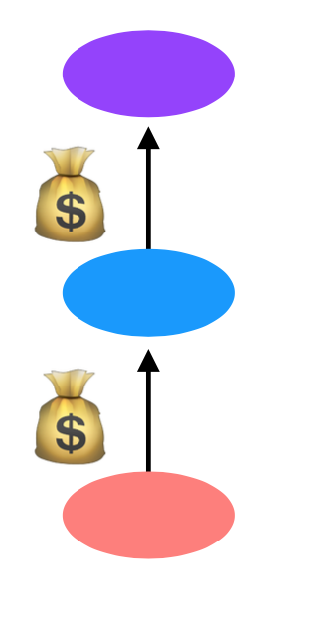
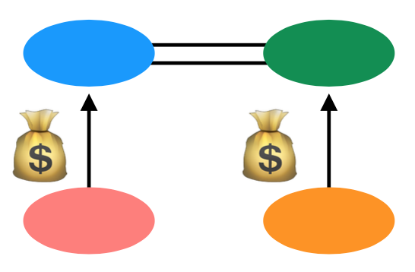
Customers and Peers
Customer/Provider ("transit")
Customer pays provider for transit
Peers
Peers allow (free) mutual access to each other's customers
buy
buy
buy

Slide 8
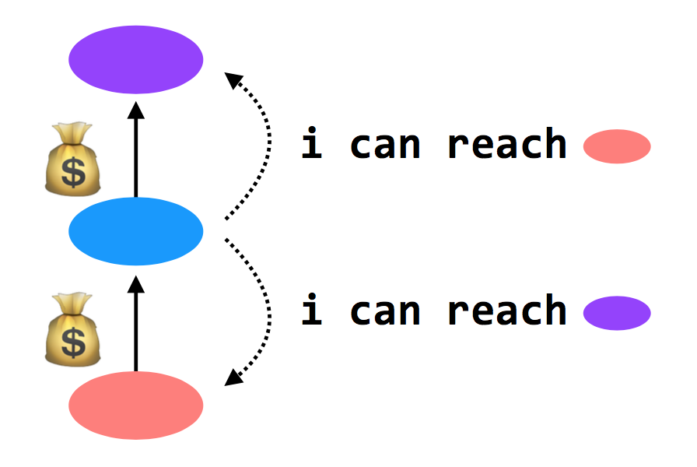
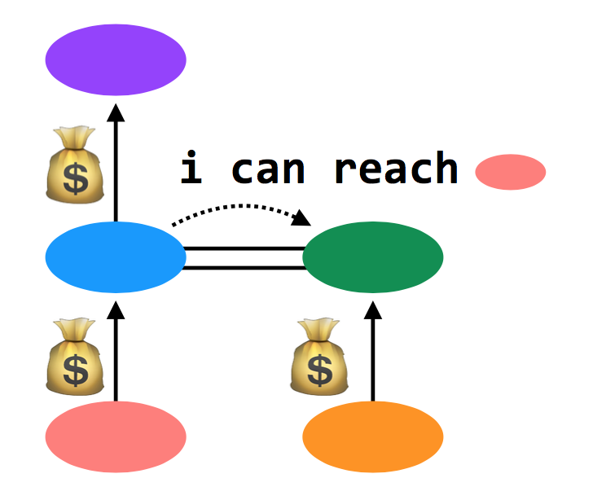
Customers and Peers
Customer/provider ("transit")
Providers tell everyone about themselves their customers
and tell their customers about everyone
Peers
Peers tell each other about their customers

Slide 9
Import Policies
Customer > peer > provider
And then a variety of other attributes when this rule isn't sufficient
Goal: make money

Slide 10
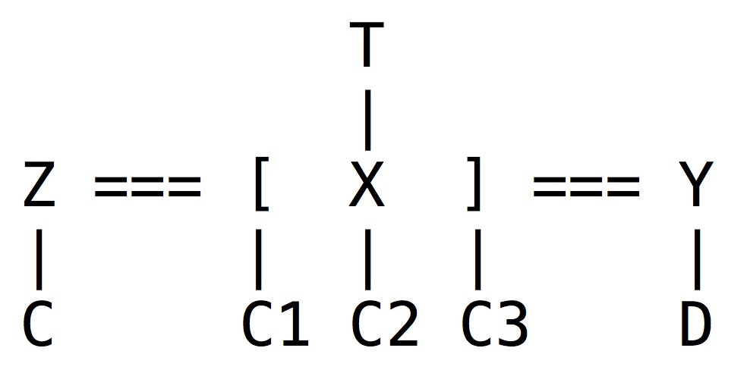

An Example
Z will tell X about C; C is a customer of Z, and X and Z are peers
X will tell Z and Y about C1, C2, and C3
Y will tell X about D
X will not tell Y about C; it makes no money to provide transit from Y to C
X doesn't tell Y about T; it would lose money to provide transit from Y to T
In example, Y appears disconnected from part of the network

Slide 11
An Example
BGP doesn't prevent this. In practice, it never happens. Because:
Almost every AS is a customer of someone else (i.e., Y would buy transit from someone)
Typically: small ASes buy Internet from Tier-3 ISPs, which buy Internet from Tier-2 ISPs, which buy Internet from Tier-1 ISPs. Tier-1's are huge; there are only a handful (10-15)
Additionally, all Tier-1 ISPs peer with one another. So each Tier-1 ISP can provide global connectivity

Slide 12
BGP in Distributed Routing
HELLO protocol
BGP sends KEEPALIVE messages to neighbors
Advertisements: Sent to neighbors
BGP runs on top of TCP
Doesn't have to do periodic advertisements to handle failure
Integration: via policies described above
Failures: routes can be explicitly withdrawn in BGP if fail
Routing loops avoided because BGP is path-vector

Slide 13
Problems with BGP
Does it scale?
Yes, it works on the Internet
But, BGP routing tables are getting big
Route instability due to misconfigurations or conflicting policies
One region can buy Internet from more than one ISP -> bigger table
Is it simple?
Yes to the protocol, but no to the implementation & operation
Is it secure?
No. A region can advertise a fake vector

Slide 14
2017: BGP hijacking! Traffic for Google, Apple, Facebook, Microsoft and other tech giants routed through Russia
http://securityaffairs.co/wordpress/66838/hacking/bgp-hijacking-russia.html

Slide 15
End-to-end Layer

Slide 16
The End-to-end Layer
Network layer has no guarantees on:
Delay - Order of arrival
Certainty of arrival - Accuracy of content
Right place to deliver
End-to-end layer
No single design is likely to suffice
Transport protocol for each class of application

Slide 17
Famous Transport Protocols
UDP (User Datagram Protocol)
Be used directly for some simple applications
Also be used as a component for other protocols
TCP (Transmission Control Protocol)
Keep order, no missing, no duplication
Provision for flow control
RTP (Real-time Transport Protocol)
Built on UDP
Be used for streaming video or voice, etc.
No "one size fits all"

Slide 18
Assurance of End-to-end Protocol
Assurance of at-least-once delivery
Assurance of at-most-once delivery
Assurance of data integrity
Assurance of stream order & closing of connections
Assurance of jitter control
Assurance of authenticity and privacy
Assurance of end-to-end performance

Slide 19
1. Assurance of At-least-once Delivery
RTT (Round-trip time)
to_time + process_time + back_time (ack)
At least once on best effort network
Send packet with nonce
Sender keeps a copy of the packet
Resend if timeout before receiving acknowledge
Receiver acknowledges a packet with its nonce
Try limit times before returning error to app
A nonce is like a random number

Slide 20
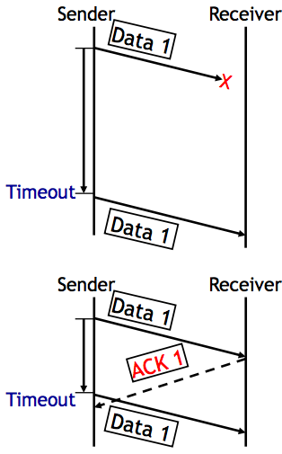
1. Assurance of At-least-once Delivery
Dilemma
1. The data was not delivered
2. The data was delivered, but no ACK received
No way to know which situation
At-least-once delivery
No absolute assurance for at-least-once
Ensure if it is possible to get through, the message will get through eventually
Ensure if impossible to confirm delivery, app will know
No assurance for no-duplication

Slide 21
How to Decide Timeout?
Fixed timer: dilemma of fixed timer
Too short? unnecessary resend
Too long? take long time to discover lost packets
Adaptive timer
E.g., adjust by currently observed RTT, set timer to 150%
Exponential back-off: doubling from a small timer
NAK (Negative AcKnowledgment)
Receiver sends a message that lists missing items
Receiver can count arriving segments rather than timer
Sender can have no timer (only once per stream)

Slide 22
Fixed Timer is Evil
Fixed timers lead to congestion collapse in NFS
Emergent phase synchronization of periodic protocols
Wisconsin time server meltdown

Slide 23
Emergent Phase Synchronization of Periodic Protocols
Periodic polling
E.g. picking up mail, sending "are-you-there?"
A workstation sends a broadcast packet every 5 minutes
All workstations try to broadcast at the same time
Each workstation
Send a broadcast
Set a fixed timer
Lesson: Fixed timers have many evils. Do not assume that unsynchronized periodic activities will stay that way

Slide 24
Wisconsin Time Server Meltdown
NETGEAR added a feature to wireless router
Logging packets -> timestamp -> time server (SNTP) -> name discovery -> 128.105.39.11
Once per second (!) until receive a response
Once per minute or per day after that
Wisconsin Univ.
On May 14, 2003, at about 8:00 a.m
From 20,000 to 60,000 requests per second, filtering 23457
After one week, 270,000 requests per second, 150Mbps

Slide 25
Wisconsin Time Server Meltdown
Lesson(s)
Fixed timers, again
Fixed Internet address
The client implements only part of a protocol
There is a reason for features likes the "go away" response in SNTP

Slide 26
How to Decide Timeout?
Fixed timer: dilemma of fixed timer
Too short: unnecessary resend
Too long: take long time to discover lost packets
Adaptive timer
E.g., adjust by currently observed RTT, set timer to 150%
Exponential back-off: doubling from a small timer
NAK (Negative AcKnowledgment)
Receiver sends a message that lists missing items
Receiver can count arriving segments rather than timer
Sender can have no timer (only once per stream)

Slide 27
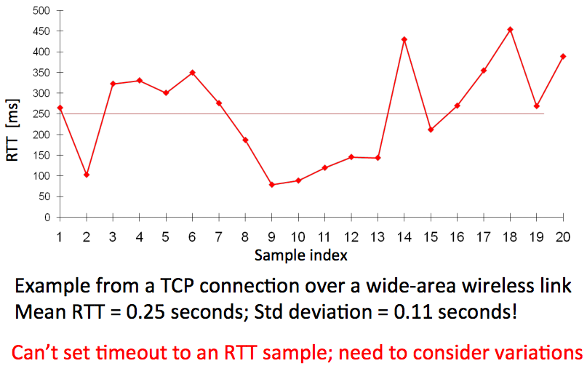
RTT Could be Highly Variable

Slide 28
Calculating RTT and Timeout (in TCP)
Exponentially Weighted Moving Average
Estimate both the average rtt_avg and the deviation rtt_dev
Procedure calc_rtt(rtt_sample)
rtt_avg = a*rtt_sample + (1-a)*rtt_avg; /* a = 1/8 */
dev = absolute(rtt_sample – rtt_avg);
rtt_dev = b*dev + (1-b)*rtt_dev; /* b = 1/4 */
Procedure calc_timeout(rtt_avg, rtt_dev)
Timeout = rtt_avg + 4*rtt_dev

Slide 29
How to Decide Timeout?
Fixed timer: dilemma of fixed timer
Too short: unnecessary resend
Too long: take long time to discover lost packets
Adaptive timer
E.g., adjust by currently observed RTT, set timer to 150%
Exponential back-off: doubling from a small timer
NAK (Negative AcKnowledgment)
Receiver sends a message that lists missing items
Receiver can count arriving segments rather than timer
Sender can have no timer (only once per stream)

Slide 30
2. Assurance of At-most-once Delivery
At-least-once delivery
Remember state at the sending side
Tends to generate duplicated requests
At-most-once delivery
Maintains a table of nonce at the receiving side
The table may grow indefinitely
Space and search time
Tombstones (something that cannot be deleted forever)
Another way: Make the application tolerate duplicated requests
Recall the NFS collapse case: server wastes time to execute duplicated requests

Slide 31
Duplicate Suppression
Monotonically increasing sequence number
Receiver discards smaller nonce, only holds the last nonce, one per sender (tombstone)
Use a different port for each new request
Should never reuse the old port number
The old port is now tombstone!

Slide 32
Duplicate Suppression
Accept the possibility of making a mistake
E.g., if sender always gives up after five RTT (cannot ensure at-least-once), then receiver can safely discard nonces that are older than five RTT
It is possible that a packet finally shows up after long delay (solution: wait long time)
Receiver crashes and restarts: lose the table
One solution is to use a new port number each time the system restarts
Another is to ignore all packets until the number of RTT has passed since restarting, if sender tries limit times
Anyway, duplicate suppression makes the system complex

Slide 33
3. Assurance of Data Integrity
Data integrity
Receiver gets the same contents as sender
Reliable delivery protocol
Sender: adds checksum to the end-to-end layer
Receiver: recalculates the checksum, discards if not match
Q: Is it redundant since link layer provides checksum?
Besides network, there could be other errors, e.g., in memory copying
The assurance is not absolute
What if a packet is mis-delivered and the receiver ACK?

Slide 34
4. Segments and Reassembly of Long Messages
Bridge the difference between message and MTU
Message length: determined by application
MTU: determined by network
Segment contains ID for where it fits
E.g., "message 914, segment 3 of 7"
Can be used for at-least-once and at-most-once delivery
Reassembly
Out-of-order, mingled with other message's segments
Allocating a buffer large enough to hold the message
Keeping a checklist for segments not arrived

Slide 35
When Out of Order…
Solution-1: Receiver only ACK in order packets, discards others
Waste of bandwidth
Solution-2: ACK every packet and hold early packets in buffer, release the buffer when all in order
Need using large buffer when waiting for a bad packet
Solution-3: Combine the two above
Discard if buffer is full
New problem: how much buffer?
Speedup for common case
NAK to avoid timeout
If NAKs are causing duplicates, stop NAKs
TCP is based on ACK, not NAK

Slide 36
Closing of Connections
Open a stream
Create a record to keep track of which elements have been sent, received, acknowledged
Close a stream
When finish, it needs to report an end-of-stream
Both ends need to agree last element is OK and then close
1. Alice sends close request to Bob with stream record ID
2. Bob checks and agrees, sends a close ACK
3. Alice receives ACK, turn off sender, discard record
4. Alice sends "all done" to Bob
5. Bob receives "all done" and discard stream record
<- What if duplicate?

Slide 37
5. Assurance of Jitter Control
Real-time
When reliability is less important than timely delivery
A few error in a movie may not be noticed
Jitter: variability in delivery time
Strategy
Basic: delay all arriving segments

Slide 38
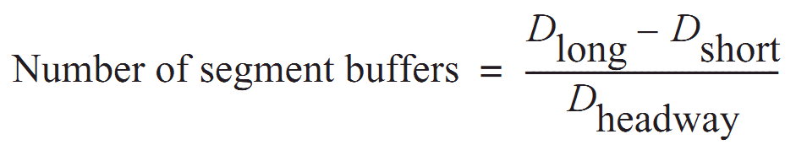
5. Assurance of Jitter Control
Measure the distribution of delays in a chart showing delay time vs. frequency of that delay
Choose an acceptable frequency of delivery failure
Determine D_{long} that longer than 99% delay
Determine the shortest delay, D_{short}
Calculate number of segment buffer:
D_{headway} is average delay between arriving segments

Slide 39
6. Assurance of Authenticity and Privacy
Internet is dangerous
Hostile intercepts and maliciously modifies packets
Violate a protocol with malicious intent
Key-based mathematical transformations to data
Sign and verify: establish the authenticity of the source and integrity of contents
Encrypt and decrypt: maintain privacy of contents
Consideration
False sense of security, worse than no assurance

Slide 40
6. Security: Asymmetric Encryption
Public Key VS. Private Key
Public key: encrypt to identify reader (only me can read this)
Private key: encrypt to identify writer (yes, it's me who wrote this)
Poor performance, so just used to exchange symmetric key
Questions
What is a certificate? Why using a CA (Certificate Authority)?
How to exchange a symmetric key in HTTPS or SSH?
What is the root of trust?
Will be addressed later, in Security part

Slide 41
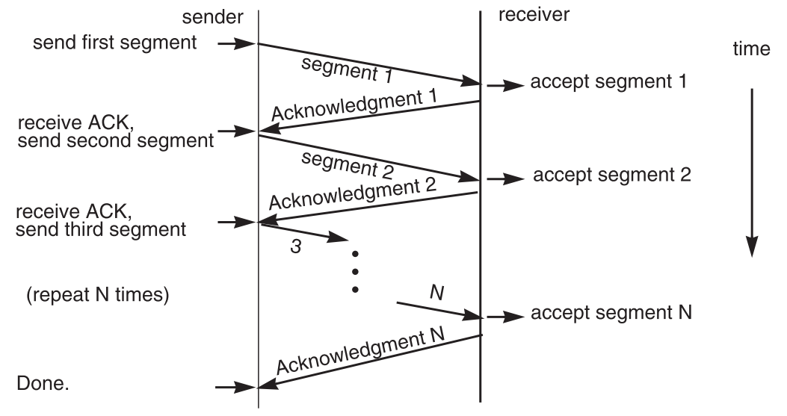
7. End-to-end Performance
Multi-segment message questions
Trade-off between complexity and performance
Lock-step protocol

Slide 42
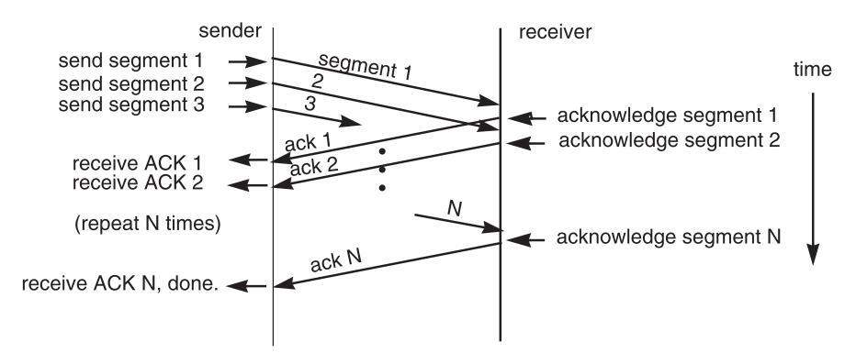
Overlapping Transmissions
Pipelining technique

Slide 43
Overlapping Transmissions: Problems
Packets or ACK may be lost
Sender holds a list of segments sent, check it off when receives ACK
Set a timer (according to RTT) for last segment
If list of missing ACK is empty, OK
If timer expires, resend packets and another timer

Slide 44
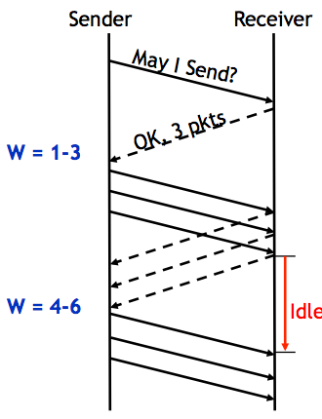
Fixed Window
Receiver tells the sender a window size
Sender sends window
Receiver acks each packet as before
Window advances when all packets in previous window are acked
E.g., packets 4-6 sent, after 1-3 ack'd
If a packet times out -> resend packets
Still much idle time

Slide 45
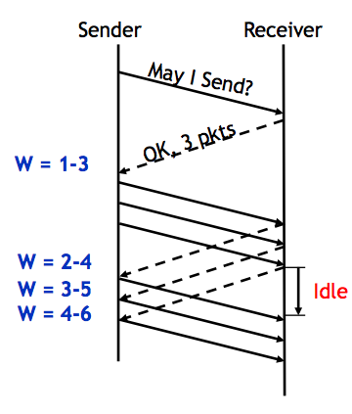
Sliding Window
Sender advances the window by 1 for each in-sequence ACK it receives
Reduces idle periods
Pipelining idea
But what's the correct value for the window?
We'll revisit this question
First, we need to understand windows

Slide 46
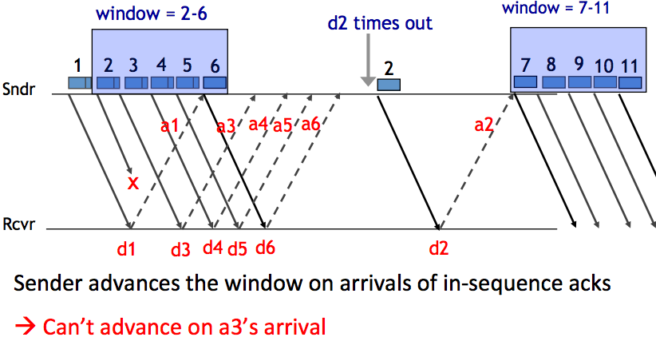
Handling Packet Loss

Slide 47
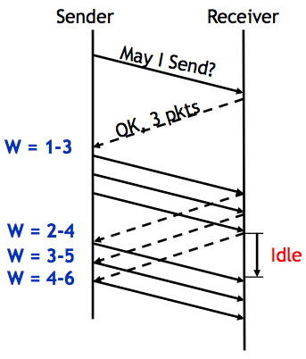
Chose the Right Window Size
If window is too small
Long idle time
Underutilized network
If window too large
Congestion

Slide 48
Sliding Window Size
window size ≥ round-trip time × bottleneck data rate
Sliding window with one segment in size
Data rate is window size / RTT
Enlarge window size to bottleneck data rate
Data rate is window size / RTT
Enlarge window size further
Data rate is still bottleneck
Larger window makes no sense
- Receive 500 KBps
- Sender 1 MBps
- RTT 70ms
- A segment carries 0.5 KB
- Sliding window size = 35KB (70 segment)

Slide 49
Self-pacing: Sliding Window Size
Although the sender doesn't know the bottleneck, it is sending at exactly that rate
Once sender fills a sliding window, cannot send next data until receive ACK of the oldest data in the window
The receiver cannot generate ACK faster than the network can deliver data elements
RTT estimation still needed
Notes:
Consider RTT is 0. Similar as bounded-buffer on a single machine.

Slide 50
TCP Congestion Control

Slide 51
Congestion
Definition: Too many packets present in (a part of) the network causes packet delay and loss that degrades performance.
Network & End-to-end layers share the responsibility for handling congestion
1. Network layer
Directly experiences the congestion
Ultimately determine what to do with the excess packets
2. End-to-end layer
Control to reduce the sending rate, is the most effective way

Slide 52
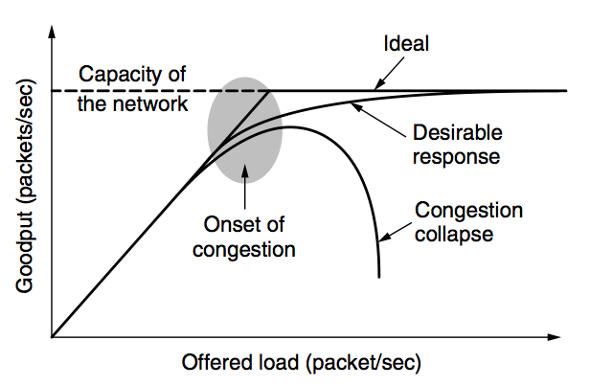
Network Congestion

Slide 53
Why Congest?
If all of a sudden, streams of packets begin arriving on three or four input lines and all need the same output line, a queue will build up
If there is insufficient memory to hold all of them, packets will be lost
Adding more memory may help up to a point, but
Nagle (1987) realized that if routers have an infinite amount of memory, congestion gets worse, not better
This is because by the time packets get to the front of the queue, they have already timed out (repeatedly) and duplicates have been sent

Slide 54
Load Shedding: Setting Window Size
For performance:
window size ≥ round-trip time × bottleneck data rate
For congestion control:
window size ≤ min(RTT x bottleneck data rate, Receiver buffer)
Congestion window
2 windows become 1
to achieve best performance and avoid congestion

Slide 55
Congestion Control
Basic idea:
Increase congestion window slowly
If no drops -> no congestion yet
If a drop occurs -> decrease congestion window quickly
Use the idea in a distributed protocol that achieves:
Efficiency: i.e., uses the bottleneck capacity efficiently
Fairness, i.e., senders sharing a bottleneck get equal throughput (if they have demands)
Notes:
cwnd: congestion window

Slide 56
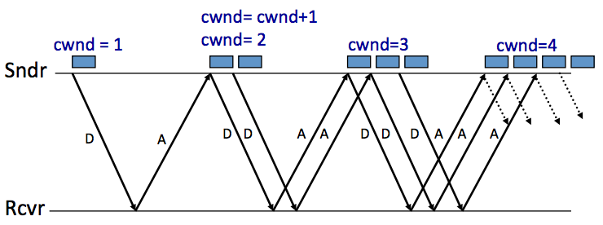
AIMD (Additive Increase, Multiplicative Decrease)
Every RTT:
No drop: cwnd = cwnd + 1
A drop: cwnd = cwnd / 2

Slide 57
Problems with AIMD
Increases very slowly at the beginning
Initial window size is 1
Probably too small in practice
Solution: do multiplicative increase at the beginning
Congestion_window _{init} = 1
Initially, do Congestion_window ← 2 * Congestion_window each RTT until we hit congestion
Named "slow start" (even though it's exponentially fast!)

Slide 58
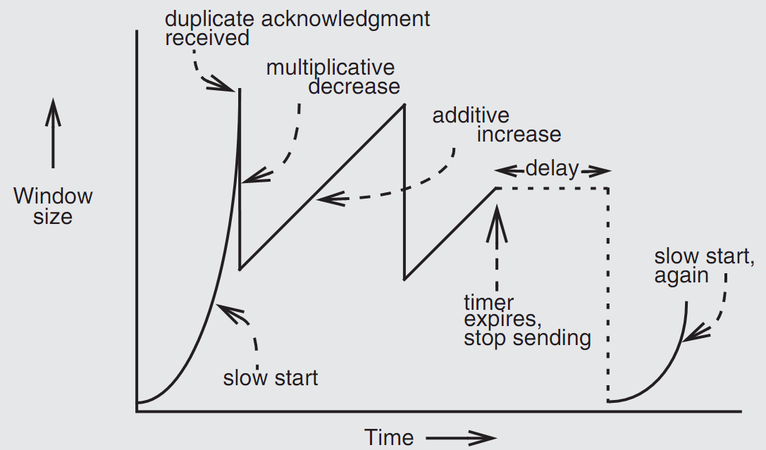
Retrofitting TCP
Notes:
Since TCP does not know whether a duplicate ACK is caused by a lost segment or just a reordering of segments, it waits for a small number of duplicate ACKs to be received.

Slide 59
Retrofitting TCP
1. Slow start: one packet at first, then double until
Sender reaches the window size suggested by the receiver
All the available data has been dispatched
Sender detects that a packet it sent has been discarded
2. Duplicate ACK
When receiver gets an out-of-order packet, it sends back a duplicate of latest ACK
3. Equilibrium
Additive increase & multiplicative decrease
4. Restart, after waiting a short time

Slide 60
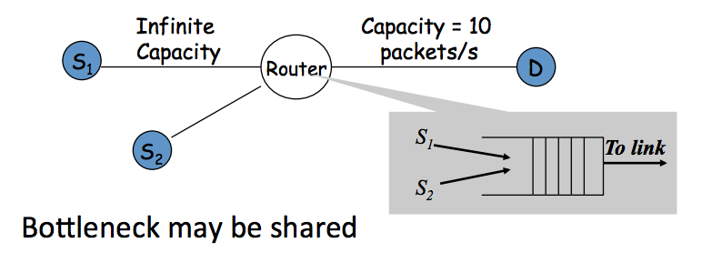
Fairness between Links

Slide 61
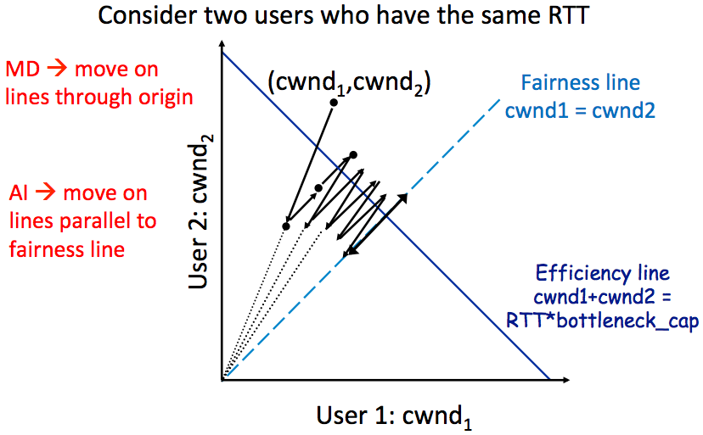
AIMD Leads to Efficiency and Fairness
Notes:
AIMD: addition increase, multiple decrease.

Slide 62
Q: Why not Additive Decrease
It does not converge to fairness
from a congested point, (x',y'), reducing each by 1 worsens fairness and takes us away from the "ideal" outcome

Slide 63
Weakness of TCP
If routers have too much buffering, causes long delays
Packet loss is not always caused by congestion
Consider wireless network: sender may send faster if losing packet
TCP does not perform well in datacenters
High bandwidth, low delay situations
TCP has a bias against long RTTs
Throughput inversely proportionally to RTT
Consider when sending packets really far away vs really close
Assumes cooperating sources, which is not always a good assumption

Slide 64
Summary of Congestion Window
Reliability Using Sliding Window
Tx Rate = W / RTT
Congestion Control
W = min(Receiver_buffer, cwnd)
Congestion window is adapted by the congestion control protocol to ensure efficiency and fairness
TCP congestion control uses AIMD which provides fairness and efficiency in a distributed way

